Slide 1

East Tennessee Mental Health Resources
Welcome to East Tennessee Mental Health Resources.
Search Resources
Search
Filter
Med MGMT
Therapists
Facilities
Student Resources
Resource 1
Resource 2
Submit New
Resource
Resource 3
Resources 1-12

Slide 2

East Tennessee Mental Health Resources
Medication Management Providers
Search Resources
Search
Filter
Med MGMT
Therapists
Facilities
Student Resources
Resource 1
Resource 2
Submit New
Resource
Resource 3
Resources 1-12

Slide 3
East Tennessee Mental Health Resources
Therapists
Search Resources
Search
Filter
Med MGMT
Therapists
Facilities
Student Resources
Resource 1
Resource 2
Submit New
Resource
Resource 3
Resources 1-12

Slide 4
East Tennessee Mental Health Resources
Inpatient Facilities
Search Resources
Search
Filter
Med MGMT
Therapists
Facilities
Student Resources
Resource 1
Resource 2
Submit New
Resource
Resource 3
Resources 1-12

Slide 5

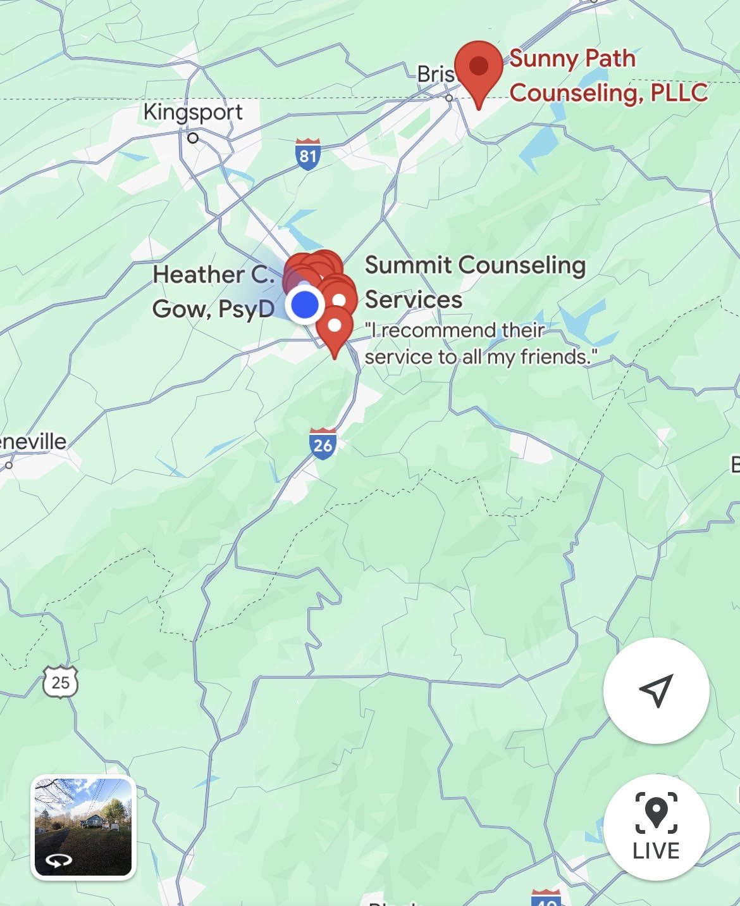
East Tennessee Mental Health Resources
Therapists
Search Resources
Search
Back to Search
Filter
Med MGMT
Therapists
Facilities
Student Resources
Janine Hinkley
Licensed Professional Counselor
Associated Practice: Sunny Paths LLC.
123 Mockingbird Lane, Johnson City, Tennessee
Accepts Insurance: Yes
Insurances Accepted: Cigna, Aetna, BlueCross BlueShield
Phone: 555-555-5555
Submit New
Resource

Slide 6
East Tennessee Mental Health Resources
Submit a New Resource
What type of resource do you want to submit?
Search Resources
Search
Search
Therapist
Medication Management
Facility
Student Related Resource

